Slide 1
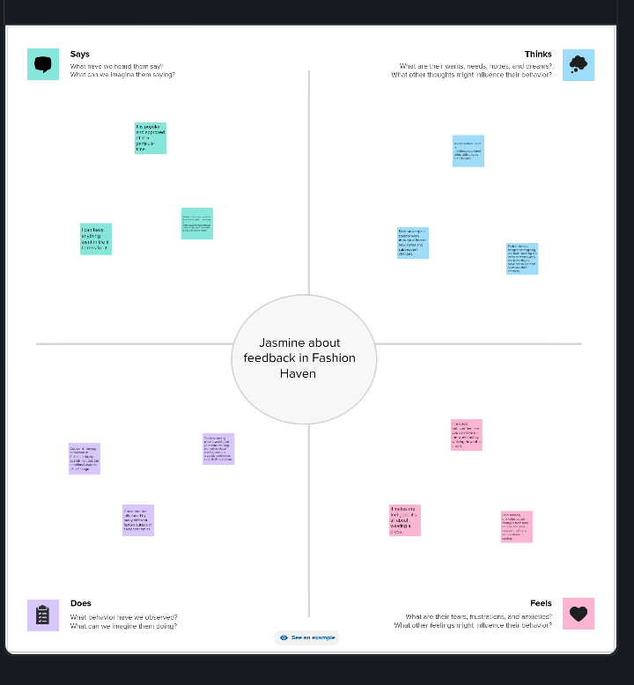
INTRODUCTION:
1.OVER VIEW
Fashion is an art form that allows individuals to express themselves through clothing and accessories. It is a constantly evolving industry that is influenced by cultural, social, and economic factors. In recent years, several types of fashion have emerged, each with its own unique characteristics and appeal.
2.PROBLEM DEFINITION &DESIGN THINKING
2.1.Empathy map

Slide 2
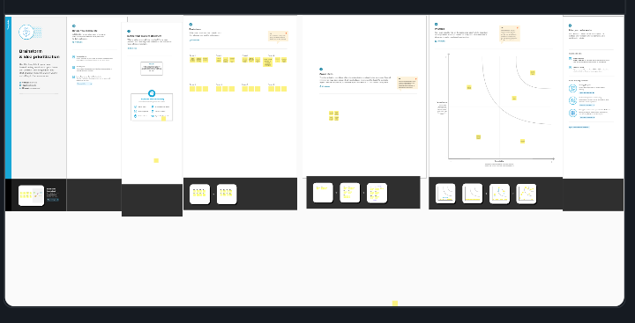
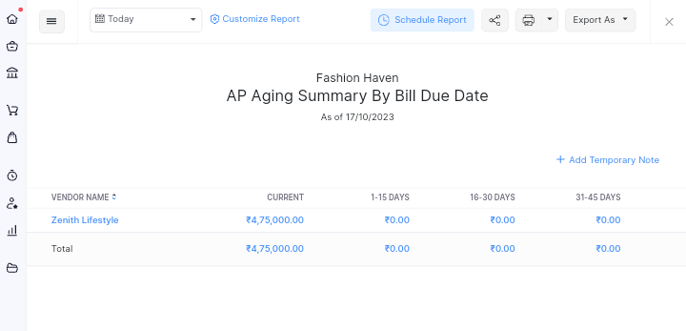
2.2 Ideation& Brainstorming Map
3.RESULTS
3.1 AP Summary

Slide 3
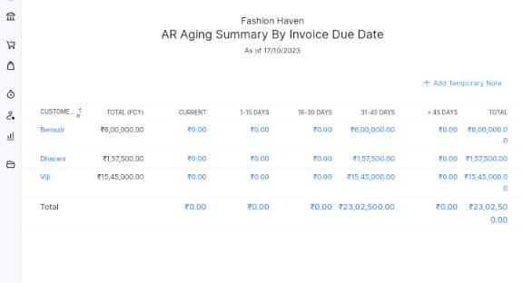
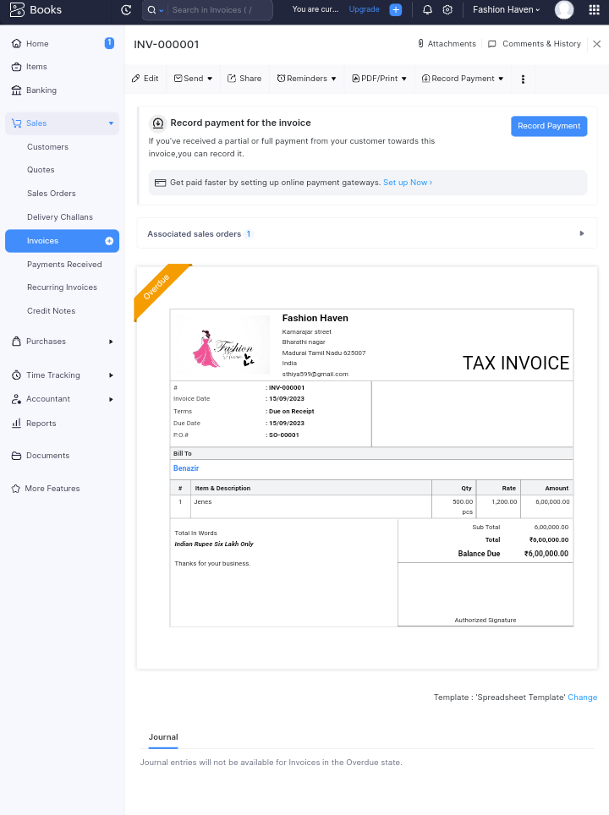
3.2.AR Summary
3.3.Sale Invoice

Slide 4
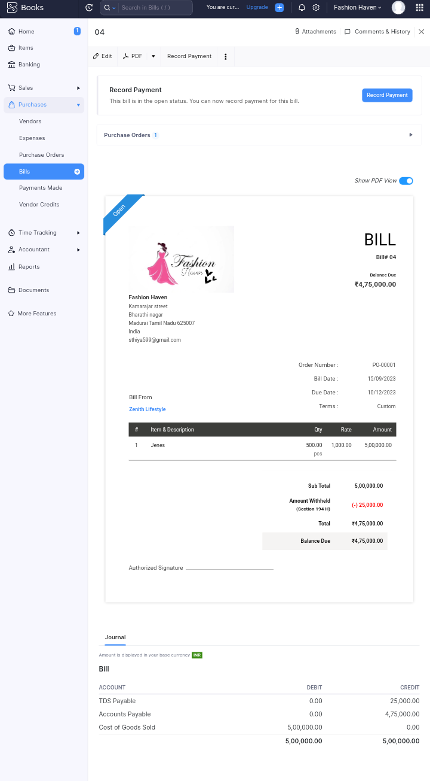
3.4.Purchase Bills

Slide 5


3.5.Vendors
3.6.Customer

Slide 6

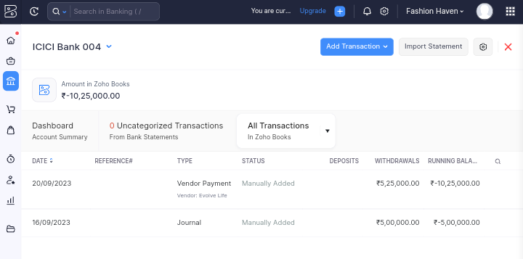
3.7.Journal
3.8.Banking

Slide 7
4.ADVANTAGES AND DISADVANTAGES
4.1.Advantages
* Confidence boost.
*Sense of accomplishment.
*Consistent wardrobe.
* Creativity.
* Happiness boost.
* Better focus.
4.2.Disadvantages
* It can be more expensive.
Some people may not like the idea of buying secondhand clothing.
*There might be a lack of options available.
Clothing that is slow fashion isn't always ethically produced.
* It can take longer to find what you

Slide 8
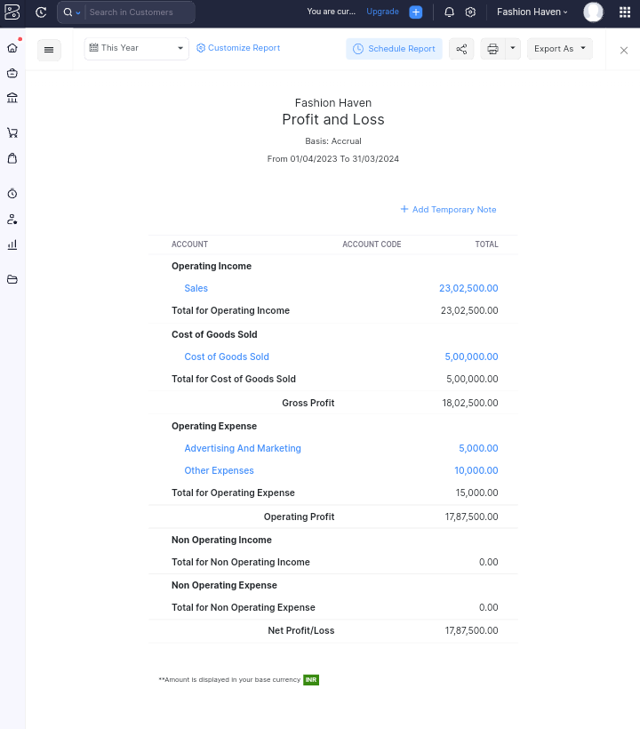
5.Conclusion
fashion design is a constantly evolving field that provides opportunities to express personal style and unique ideas
5.1.Profit and Loss Account

Slide 9
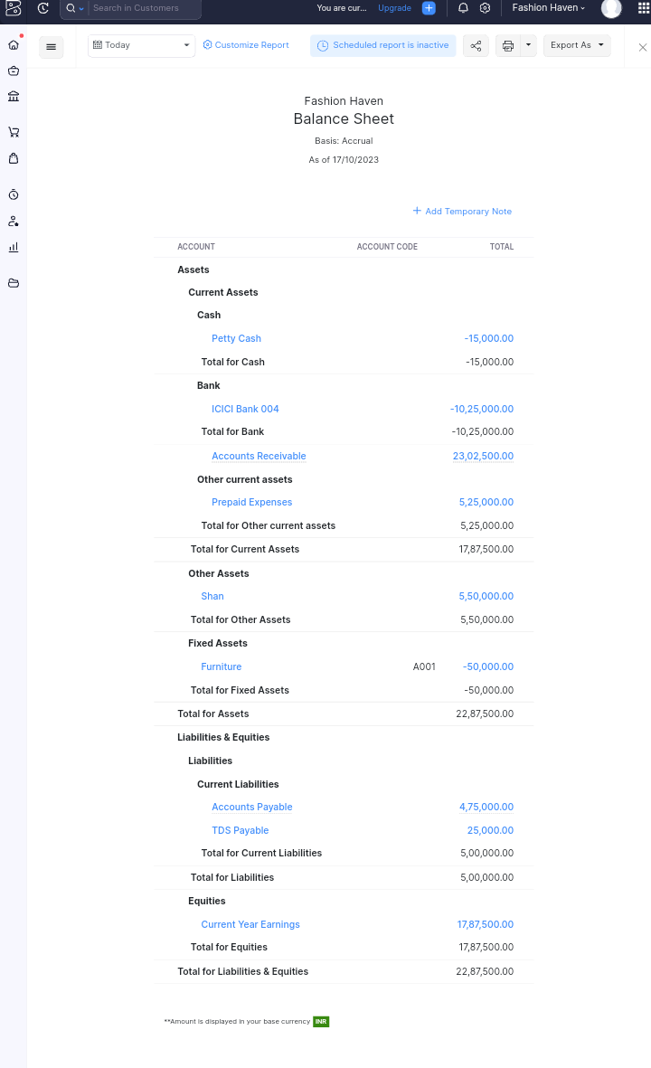
5.2.Balance Sheet

Slide 10
6.Future Scope
Fashion designing is considered to be an extraordinary course and has an extraordinary scope as well. For instance, the rise in the E-commerce fashion world, wherein you can purchase all your outfits and accessories online has led to an inclination in the demand for fashion designers as well.

